Slide 1

ARABIC MEALS ON WHEELS
offering quality and convenience
Presented by

Slide 2


Slide 3
Mission statement
To be the best provider of the wide range delicious Arabic food product around, offering convenience and friendly environment, that assures the client of the highest level of quality and best value for money.

Slide 4
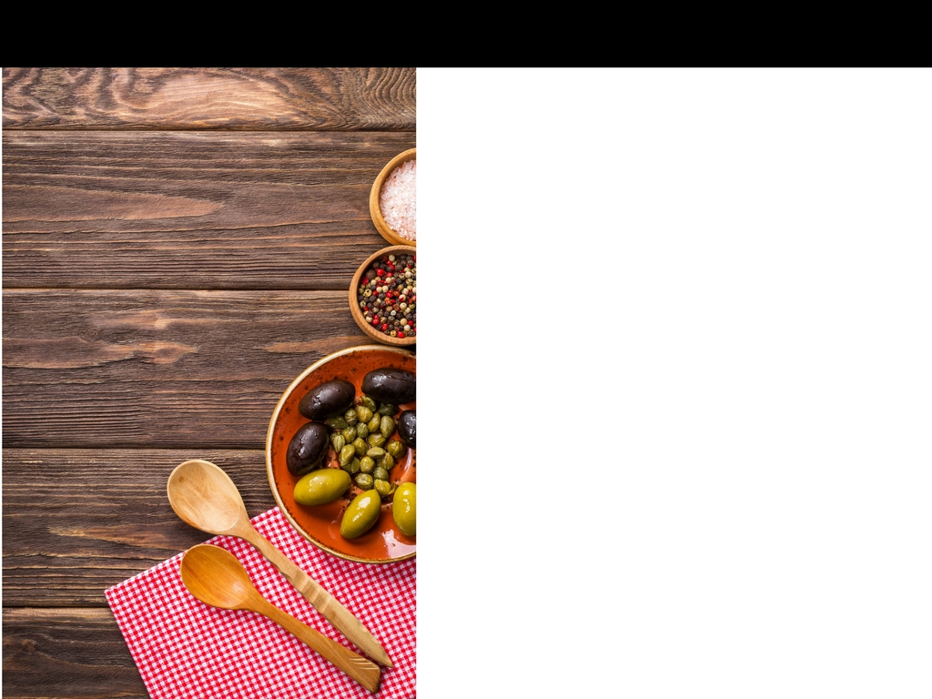
Restaurant Concept
The name; ‘Arabic Meals on Wheels’
The venture, delivers the Arabic cuisines to clients with convenience and class.
A diverse menu that offers client the Arabic meals of high quality sticking to ‘Halal’

Slide 5
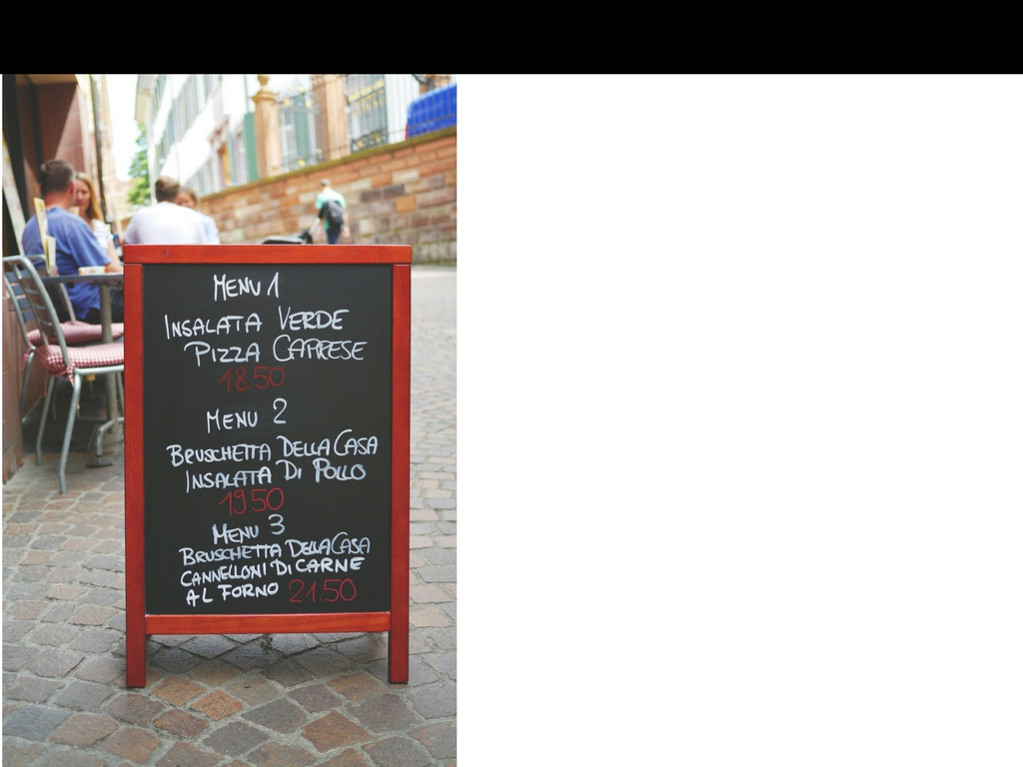
Menu characteristics
Arabic meals on wheels, will be very particular with the meals that are offered. Investing in research and training to offer the best flavors and the right cuisine. Coming up with standardized recipes to offer the best Arabic cuisines there are.

Slide 6
Menu characteristics
Arabic meals on wheels will stick to offering the best of the Arabic cuisines. Sticking to the best flavors, texture, just the right amount of seasoning and crisp to keep clients happy.
The meals will be halal. Sticking to the highest standards of cleanliness and pork free environments.
Serving fresh meals is a priority. Maintaining the freshness of the herbs, spices and oils used on the meals to give the best flavor and aroma.
The restaurant will stick to a table d'hôte menu. This is to ensure efficiency in service.

Slide 7

VALUE PROPOSITION

Slide 8
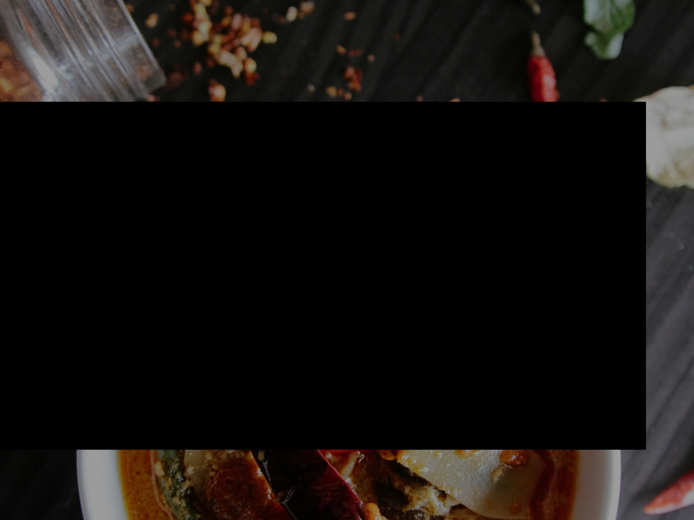
To keep with the clients expectations, the restaurant will aim at providing convenience and unique experience to clients.

Slide 9
VALUE PROPOSITION
Value proposition
Attentive and personalized customer service. Reservation based booking to avoid inconveniences.
Use of party trays to server the full meal. No use of forks, spoons or knives ass a way to realize the true Arabic cuisine experience.
Adequate seating space and resources for quality service. Clients sit on carpeted floors on quality cushions and spacious low level tables.
The best Arabian décor, curved word art, mahogany surfaces, Arabic rugs and urns.
Arabian light fixtures and adequate yellow lighting to give off the right ambiance.
Secure and trustworthy order payment platform

Slide 10

MARKET
ANALYSIS

Slide 11
The restaurant will offer unique cuisines.
The main target market will entail the Millennials who have great interests in exploring foods from diverse cultures and also have disposable income. Another target group is the culinary tourists.
Through offering quality, and affordability coupled with convenience, the restaurant will be in a position to accrue market share.

Slide 12
Competitive analysis
COMPETITIVE ANALYSIS
The main competition for Arabic meals on wheels are the major fast food delivery restaurants who dominate the meals on wheels market.
The restaurant also faces competition from major Arabic restaurants such as Kobee Factory, Hayat’s Kitchen and The Flying Falafel
This calls for Arabic meals on wheels to adopt a penetrative pricing strategy before initiating the major pricing strategy.
Also to divert the attention from fast food delivery, a marketing strategy to sell, the healthy foods they offer would increase preference to the Arabic meals.

Slide 13

MARKETING MIX
7Ps Analysis

Slide 14
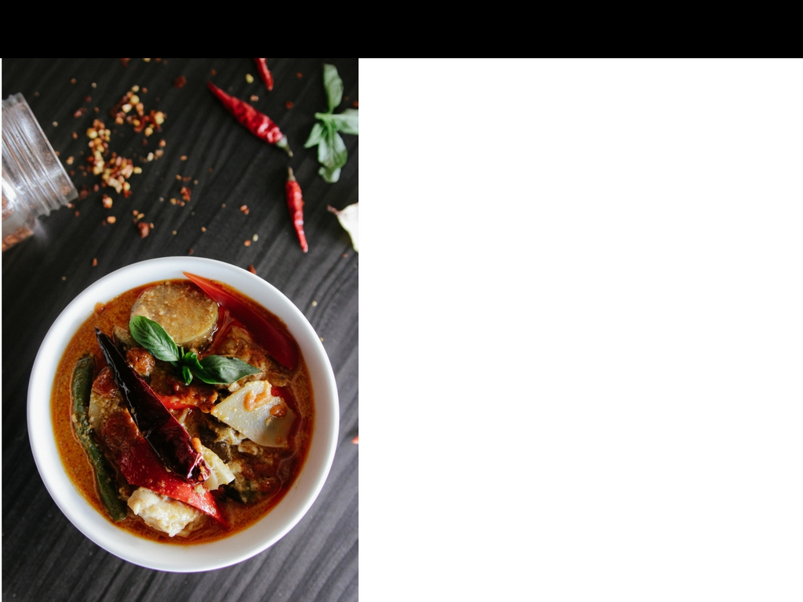
IMPORTANCE OF THE 7Ps
The 7Ps in marketing mix will allow the restaurant to review and define key issues that affect the marketing of its meals and general product

Slide 15
Product; the restaurant product will be fresh tasty and authentic Arabic cuisine alongside quality service. Quality will be assured from the investment on research for recipe development and staff training as well as acquiring the best quality ingredients to make the food.
Prices; the restaurant will adapt the cost plus pricing or ideal food cost model. This pricing model will enable the restaurant to maintain quality and continuity.

Slide 16
Place and Access; the restaurant will be situated in New Jersey and online. The online presence will allow reservations and delivery on orders.
Promotion; Digital marketing, the use of reviews on the website to get customer feedback and insight.
Processes; the restaurant is invested in cuisine research, critics review to keep up with the quality and staff training to offer the best services to customers

Slide 17
People; the staff members will be recruited on the basis of skill and competence in culinary arts specified to Arabic cuisines. Staff training is a priority to keep the skills improved. A department aimed at marketing will be recruited in order to keep sales on the rise.
Performance; the restaurant aims to provide the very best of the Arabic cuisines and deliver door to door offering convenience in the process.

Slide 18

Marketing Campaign
Find more investors
Include TV and print advertisements
Conduct extensive market research and adjust the marketing strategies
Strengthen presence on social media
Get reviewed by food critics

Slide 19
FRANCHISING CONCEPT

Slide 20
Arabic meals on wheels will stick to a franchising concept that offers all rounded benefits for the parties involved, while offering consistency and convenience to clients.

Slide 21
The franchise or the royalty fees will be priced at 4% of the gross sales revenue.
The franchise rules will streamline the general experience. Sticking to the menu is key to offering quality.
Offer training for staff members in order to ensure proper and harmonized service across.
Offer replication capability for the franchise. This is in order to maintain consistency in service as well as allow clients to have same experiences in all branches.

Slide 22
INITIAL FRANCHISE FEE
The initial Franchise fee
Items | Estimated costs
Cost of granting franchise | $ 10,000
Initial Training | $ 4,000
Support For setting up | $7,000
Profit margin | $9,000
INITIAL FRANCHISE FEE | $30,000

Slide 23
FRANCHISE FEES AND COSTS
FRANCHISE FEES AND COSTS
Item | Estimated Fee
Initial Franchise fee | $30,000
Business licenses, taxes and utilities | $15,000
Marketing expenses | $ 10,000
Prepaid expenses; insurance, security deposits | $4,000
Initial supplies and resources | $10,000
Human resource cost | $10,000
Staff Uniforms | $4,000
Estimated Total | 83,000

Slide 24
References
REFERENCES
Tharavath, V., Gupta, D., & Gunasekar, S. (2017, February). Factors influencing choice of cuisines while Indian consumers eat out. In Data Management, Analytics and Innovation (ICDMAI), 2017 International Conference on (pp. 157-160). IEEE.
Huang, R., & Sarigöllü, E. (2014). How brand awareness relates to market outcome, brand equity, and the marketing mix. In Fashion Branding and Consumer Behaviors (pp. 113-132). Springer, New York, NY.
McCraw, T. K., & Childs, W. R. (2018). Franchising and McDonald's. American Business Since 1920: How It Worked, Third Edition, 173-198.
Osterwalder, A., Pigneur, Y., Bernarda, G., & Smith, A. (2014). Value proposition design: How to create products and services customers want. John Wiley & Sons.

Slide 25
